Slide 1



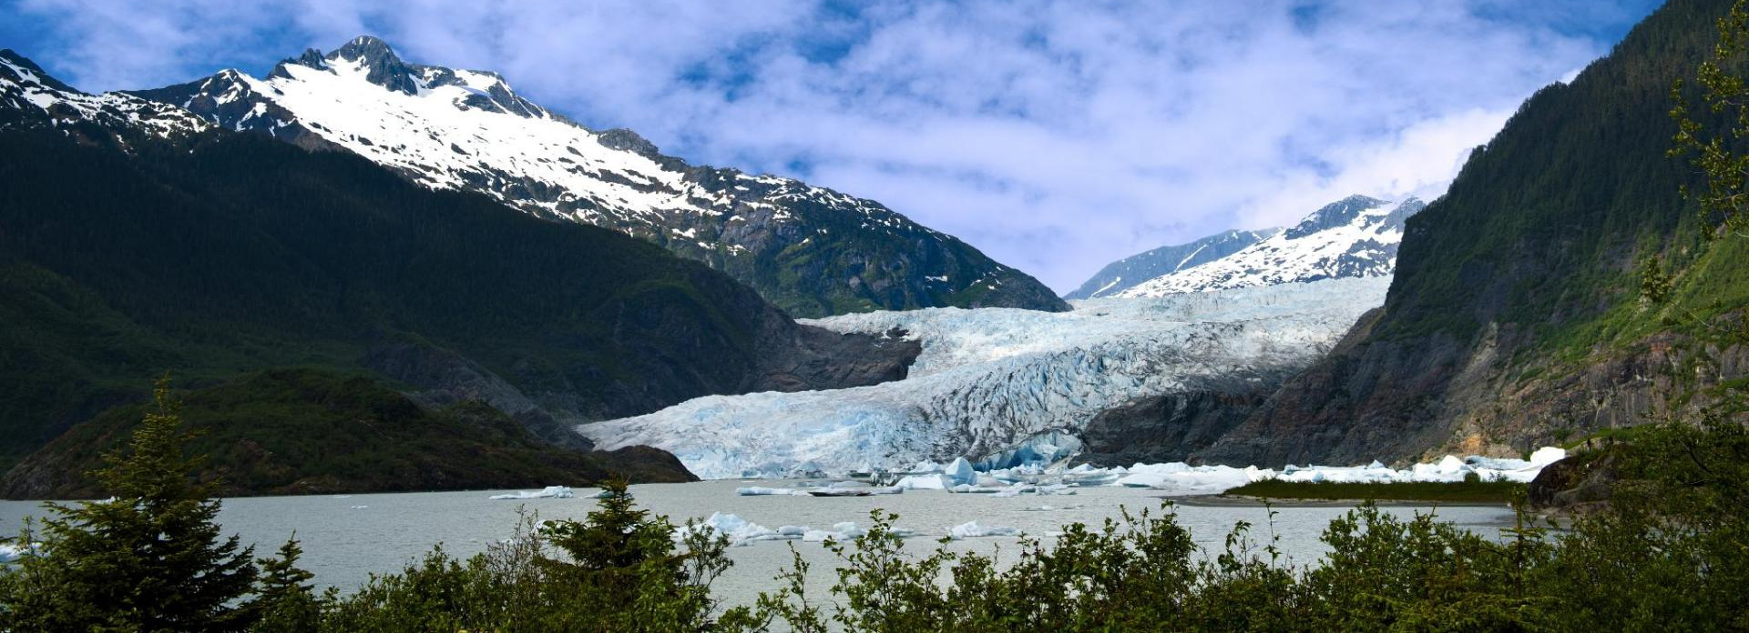
Flathead Sole
GOA Plan Team
Nov 2022
Maia Sosa Kapur
Cole Monnahan

Slide 2
Stock Overview
GOA
Flathead Sole (Hippoglossoides elassodon)
Tier
3a
Area
GOA (mostly Central and Western)
Status
Not overfished/no overfishing
Changes
Model structure:
none
Update:
input data
ageing error matrix
software platform
Notes:
directed fishery with bottom trawl gear, jan - nov
mostly w, CGOA

Slide 3
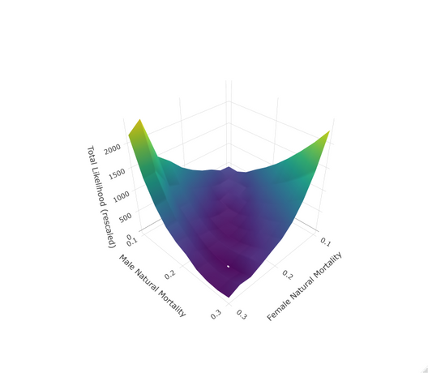


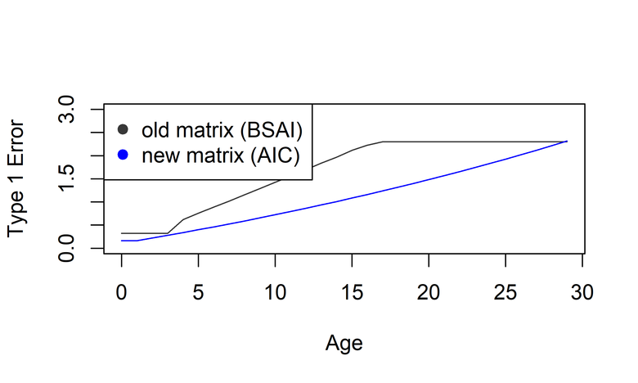
SSC/CIE Comments
Update Ageing Error Matrix
Explore M and q
Explore/quantify scientific uncertainty
2d likelihood profiles
Punt et al. (2008)
R0 profiles
Explore sensitivities and data weighting
Notes:
last full in 2017
accrued comments from council and CIE which included rex/dover
briefly touch on scope, dig into these shortly. these are key ones.
age error has been changed for recommended model using actual goa data.
profiling: some was repeat for consistency, extended.

Slide 4
Data Summary
Source | Data | Years
U.S. trawl fishery | Catch biomass | 2022
U.S. trawl fishery | Catch length composition | 1982, 1991, 1992, 1993, 1994, 1995, 1996, 1997, 1998, 2000, 2001, 2002, 2003, 2004, 2005, 2006, 2007, 2008, 2009, 2010, 2011, 2012, 2013, 2014, 2015, 2016, 2017, 2018, 2019, 2020, 2021, 2022
GOA bottom trawl survey | Survey biomass | 1984-1999 (biennial)
GOA bottom trawl survey | Survey length composition | 1984-1999 (biennial)
GOA bottom trawl survey | Survey age composition, conditioned on length | 1990, 1993, 1996, 1999, 2001, 2003, 2005, 2007, 2009, 2011, 2013, 2015, 2017, 2019, 2021

Slide 5
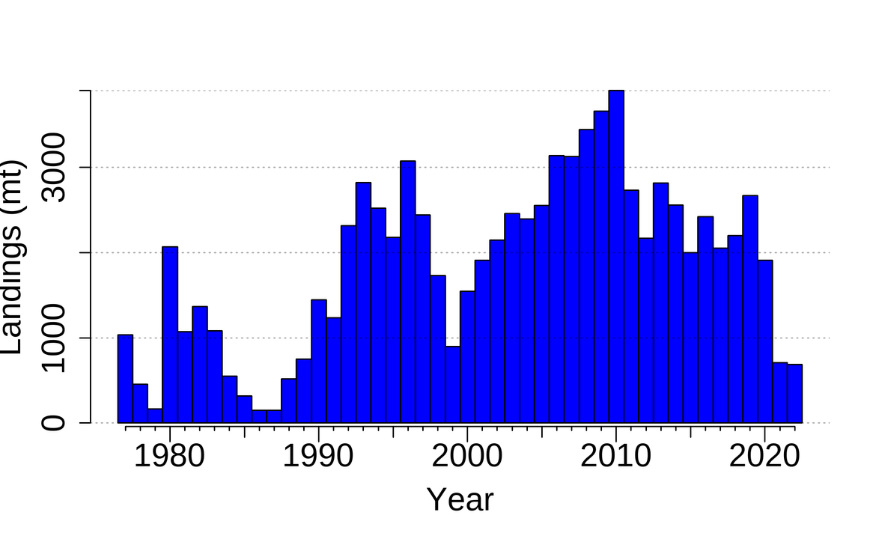
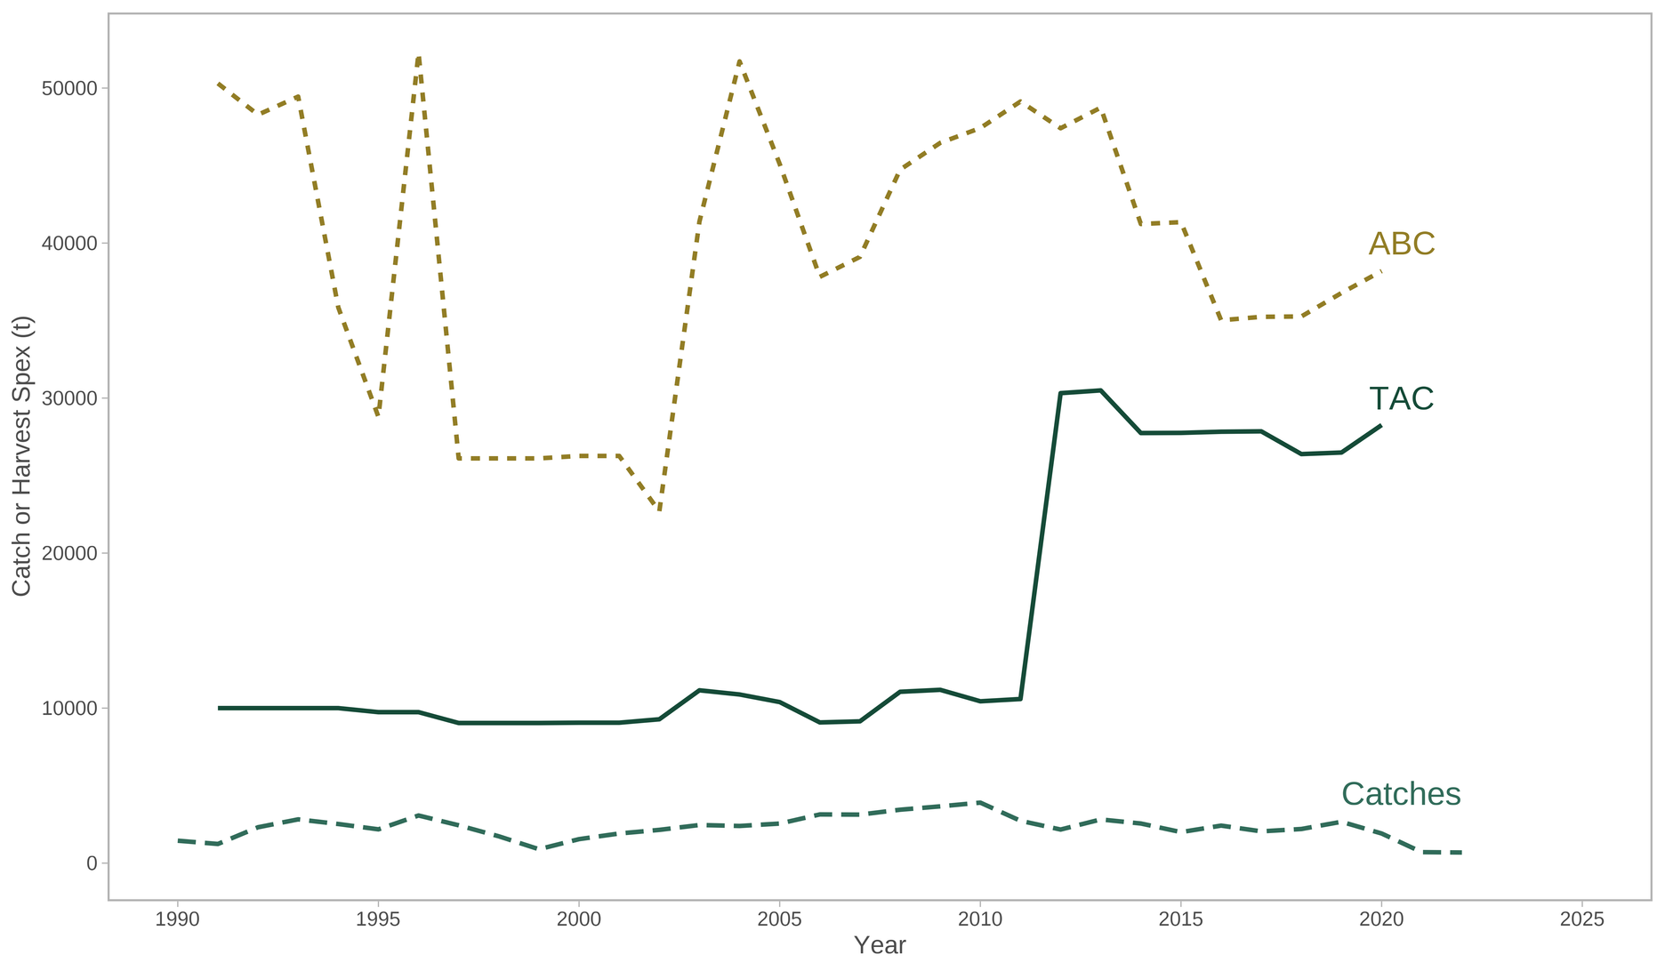
Catches

Slide 6
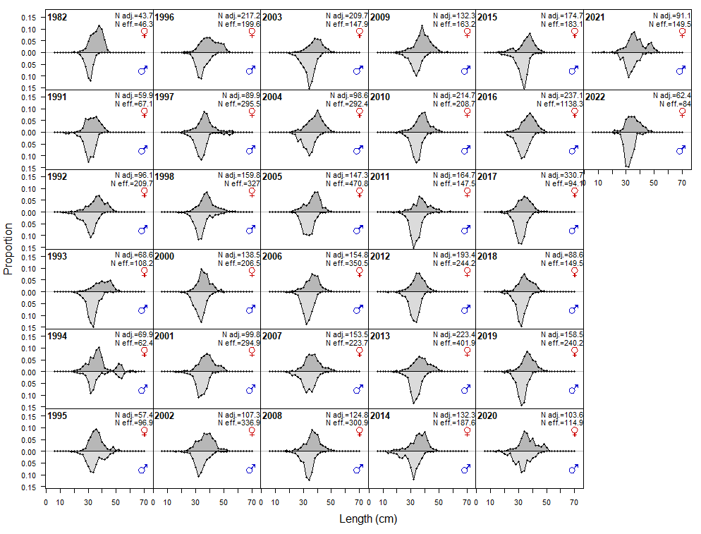
Fishery Length Composition Data
Notes:
smooth trend, m mostly 30-35, females about 10 above that.
anomly in 2020-2022. don't want to speculate too much since we haven't had a chance to re-observe,see roughly same median behavior but irregullarity in composition. two things: sample sizes are down, MHW could have impacted them (a 30cm fish is about 5 - corresponding to blob). things appear more stable in 2022.

Slide 7
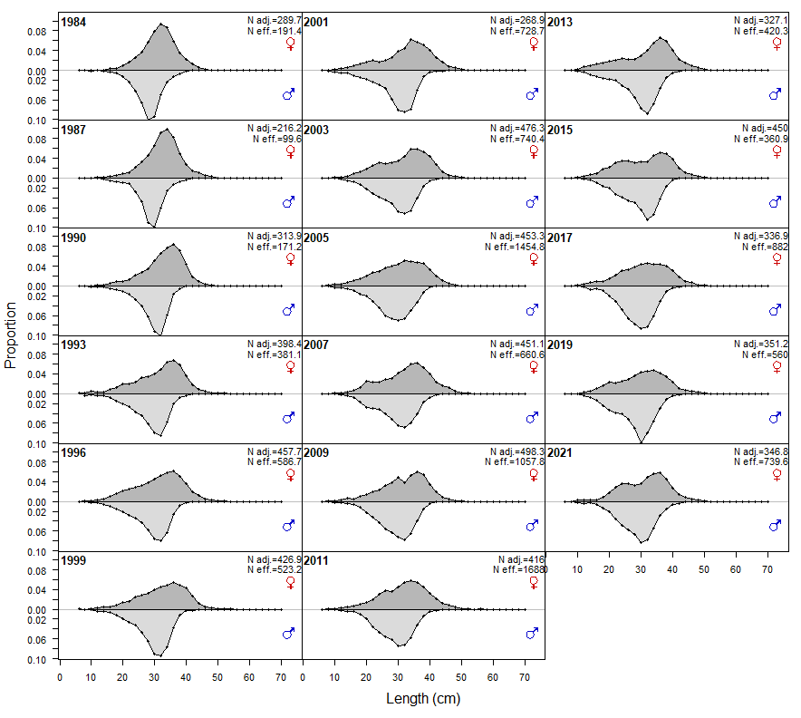
Survey Length Composition Data

Slide 8
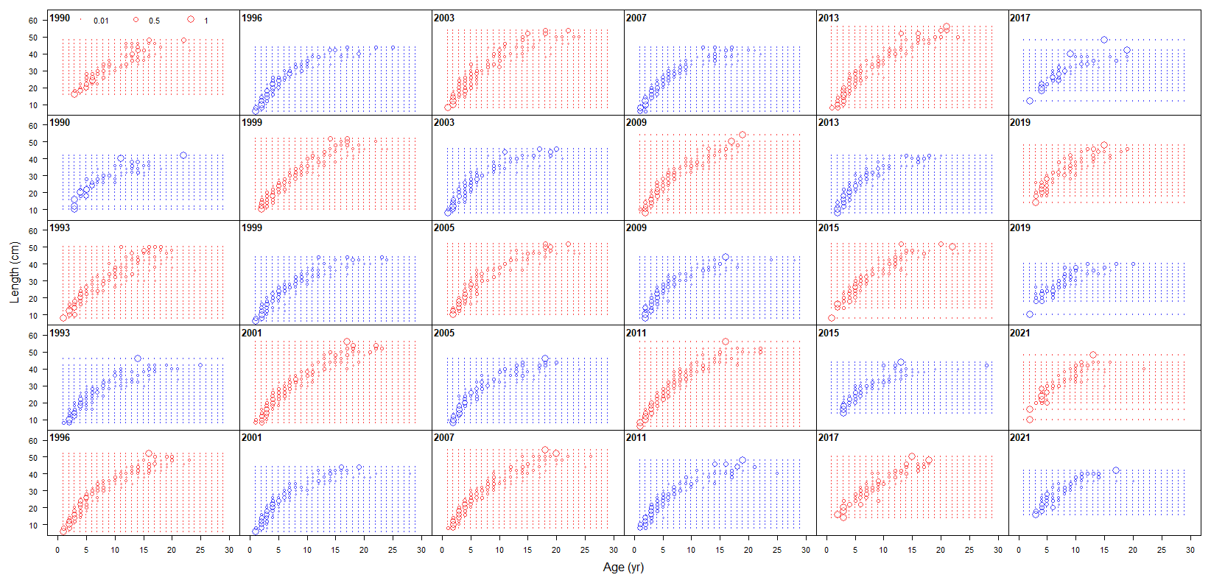
Survey CAAL data
Notes:
2017+ less clear pulse of young and small individuals, important for our recruitment

Slide 9
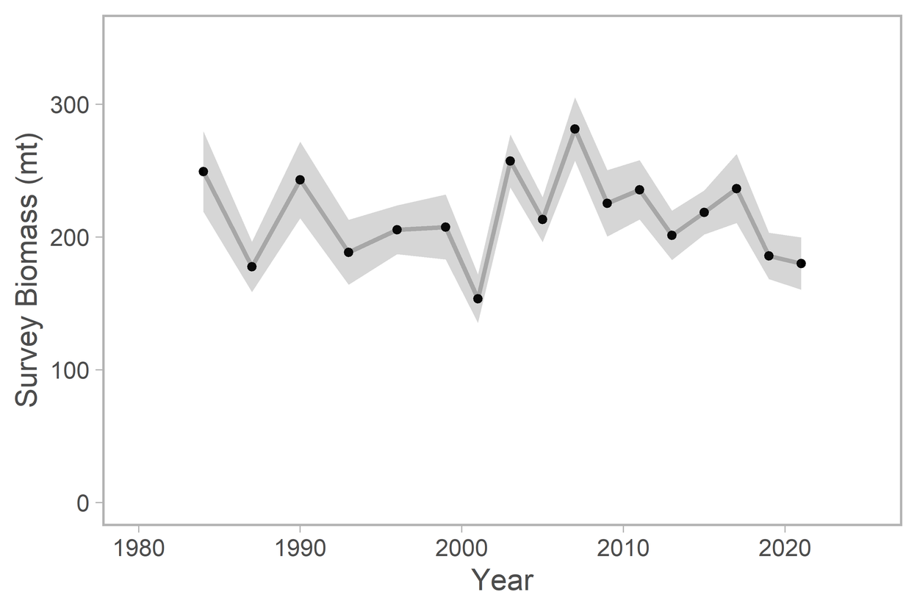
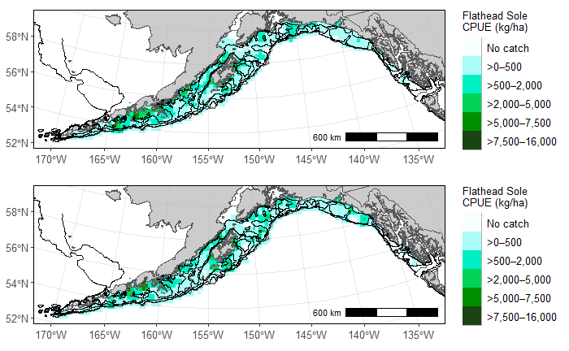
GOA Trawl Survey Data
Notes:
last 2 years slightly down, not out of realm of uncertainty

Slide 10
Model Summary
No changes from 2017 (Turnock et. al.)
Software
Bridged from SSv3.24 to SSv3.30.17
General
Split-sex, age structured (29+)
Logistic age selex
Logistic maturity
Approach
Bridge to new SS version
Add in new data & ageing error matrix
Update M-I weights
Profiles
Sensitivities
Projections
Notes:
lengths 70+
Fishery age selex 50% about age 8; survey about age 4.
50% maturity at age 8.75 (95% at 12.75).

Slide 11

Model Results
From Model 17.1a (2022) - Links to extra sensitivity runs are in document
Model fits
Parameters & Derived Quants
Retrospectives, sensitivities
Projections,
Apportionment,
Risk Table
Gaps/Research

Slide 12
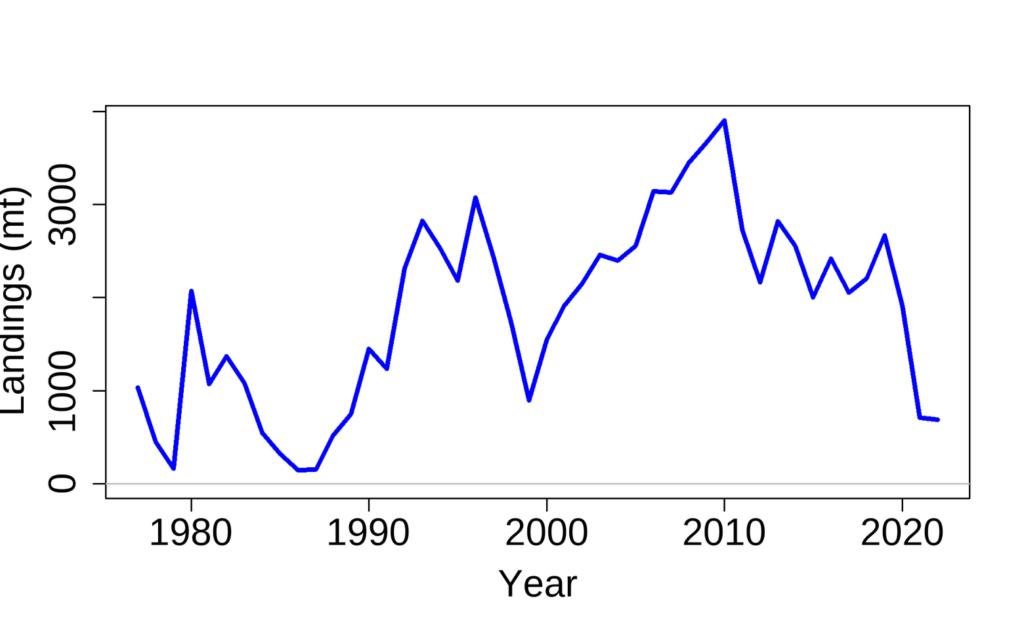

Model Fit: Catches

Slide 13
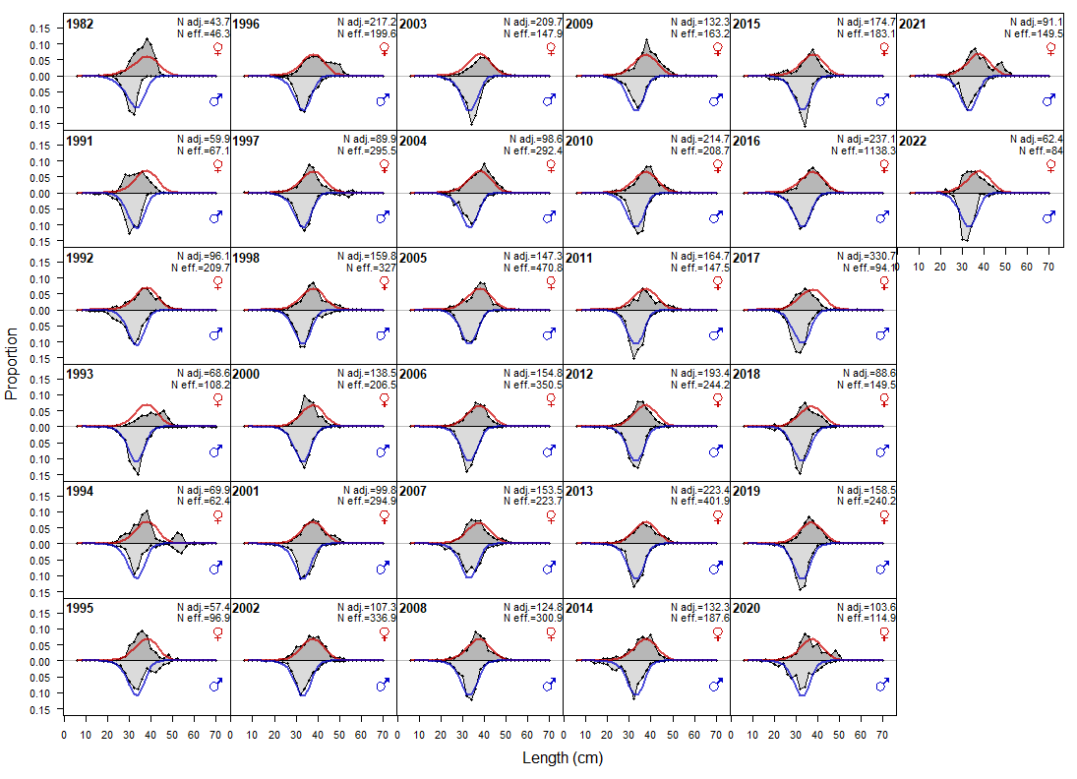
Model Fit: Fishery Lengths
Notes:
length fits overall good
recent years seems to be overfitting
in doc shows that mean L has declined, consistent with lower observed biomass
model is struggling to reconcile these changes with the reduced catches, mean recruitment

Slide 14
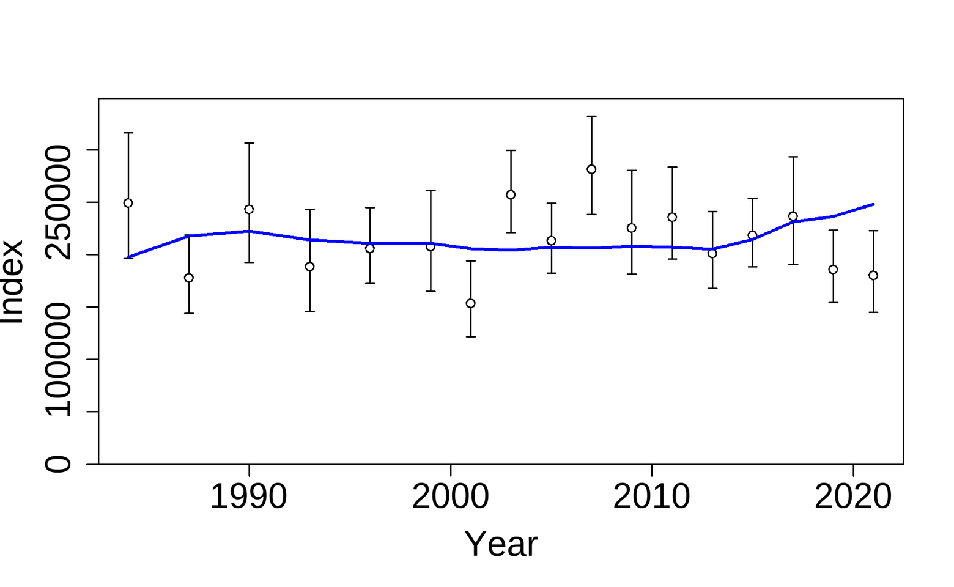
Model Fit: Survey Biomass
Notes:
struggle to capture last two years
on the whole this is a very low info survey - not not valuable, just not a lot of contrast to inform dynamics, which are probably moreso coming from the compositional data.
VAST data is more stable
we definitely sample them well at depth, so this could be 2d extent
[i think this is because the model, given the info from the CAALs and l comps, thinks recruitment was low in 2016 and 2019. three years later they should show up in the survey, corresponding to low biomass/meanL etc in 2019,2021. So this is likely a true phenomenon].

Slide 15
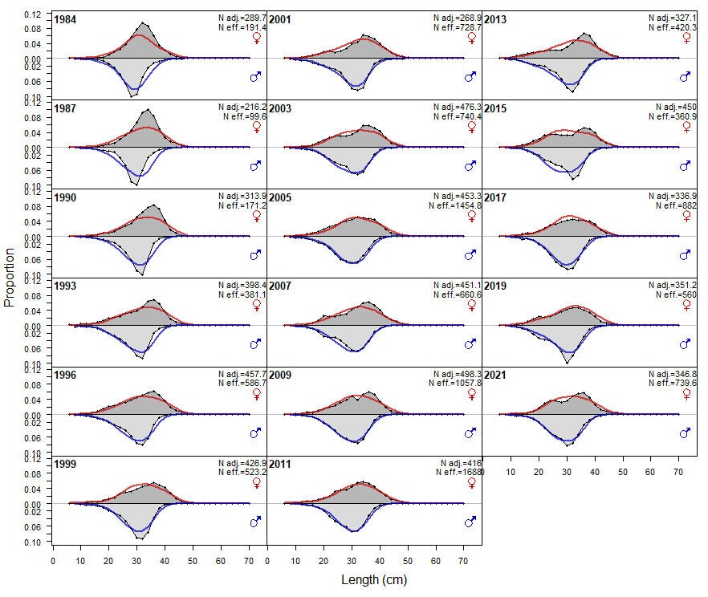
Model Fit: Survey Lengths

Slide 16
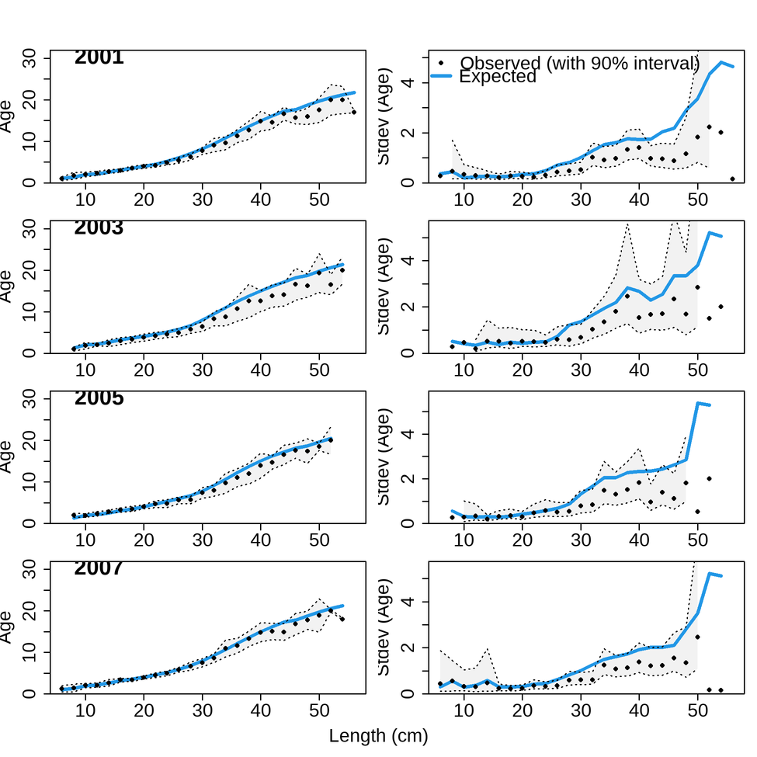
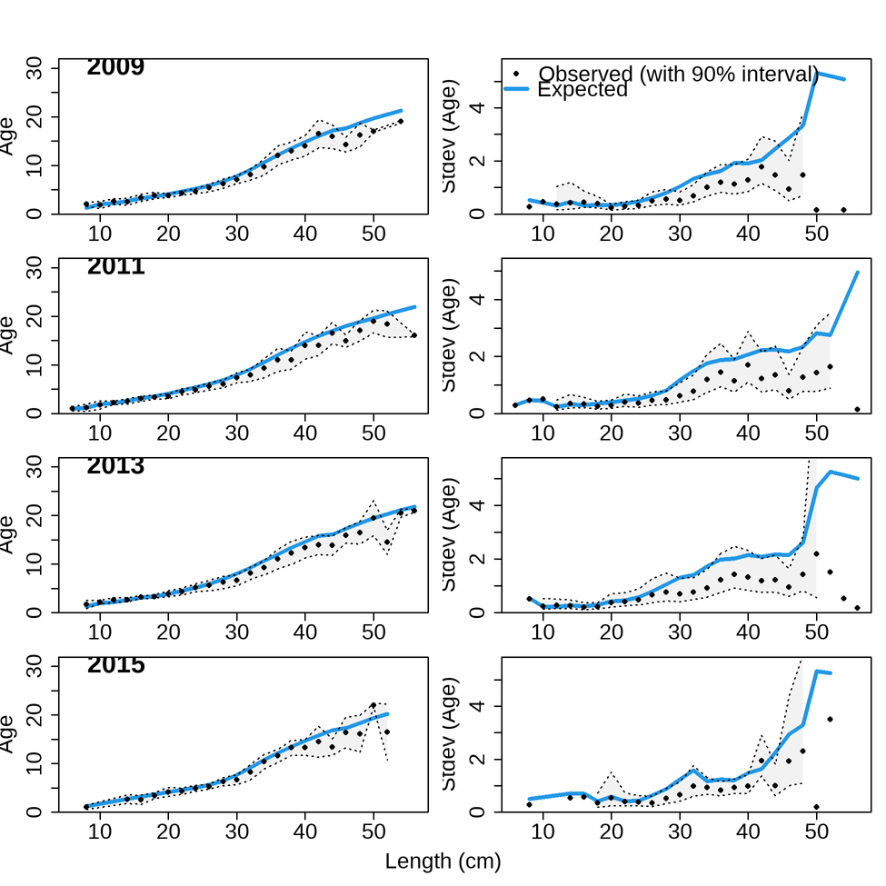
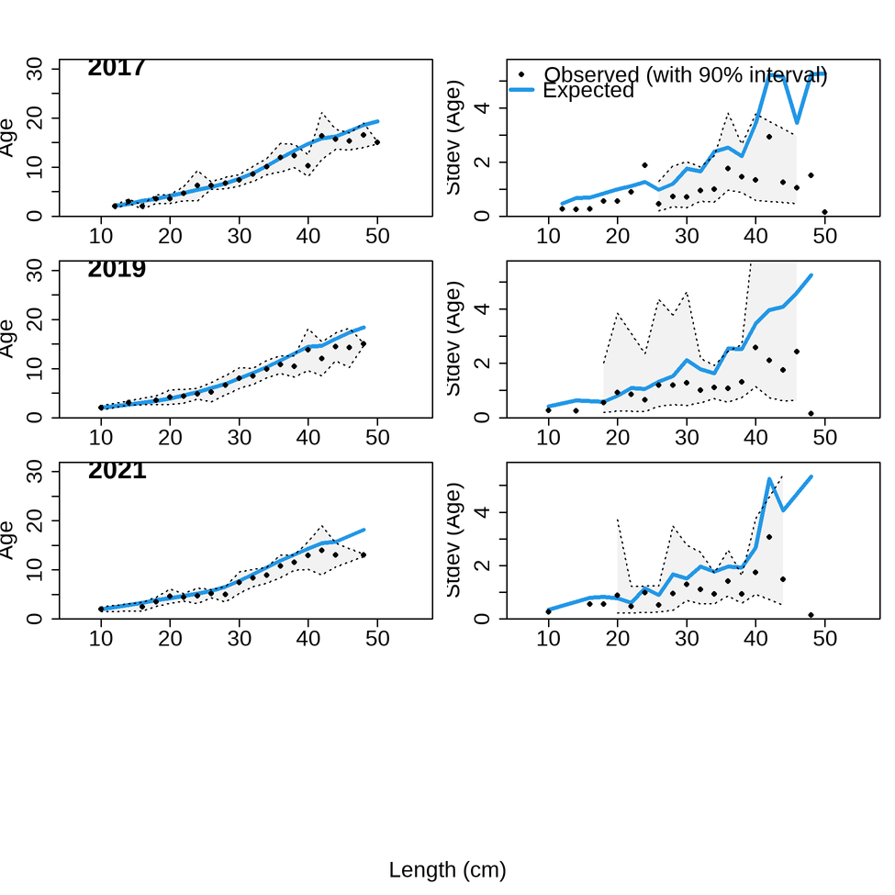
Model Fit: Survey CAAL

Slide 17
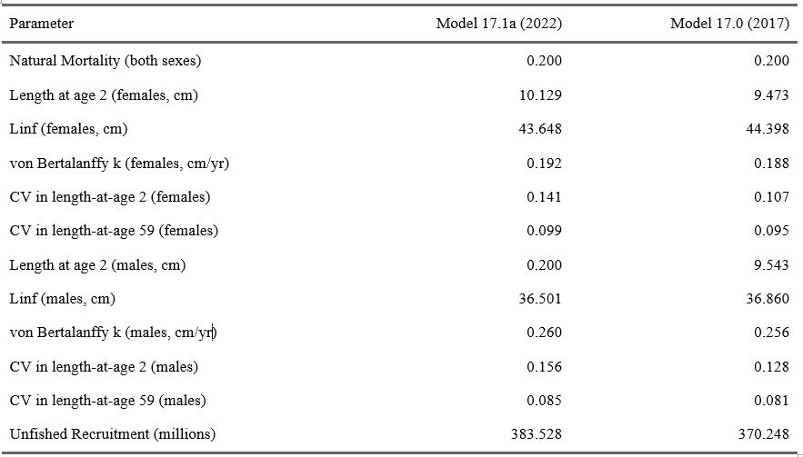

Parameters

Slide 18
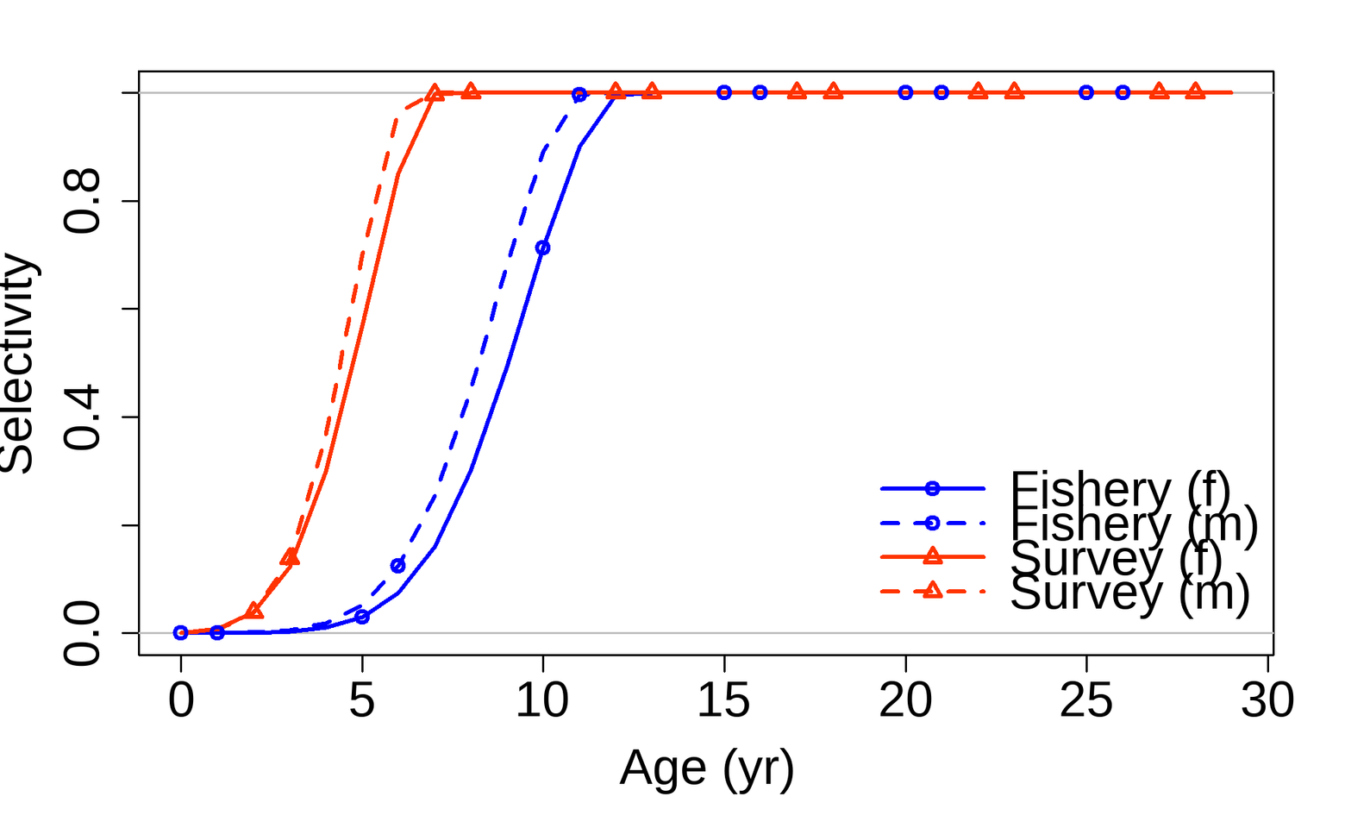
Selectivity Curves
Notes:
2017 also thought it odd that M selected earlier given they grow smaller.
Didn't monkey in depth; consider as offset?
Other models can dump weird processes into agesel for no reason (like a comps bump).

Slide 19
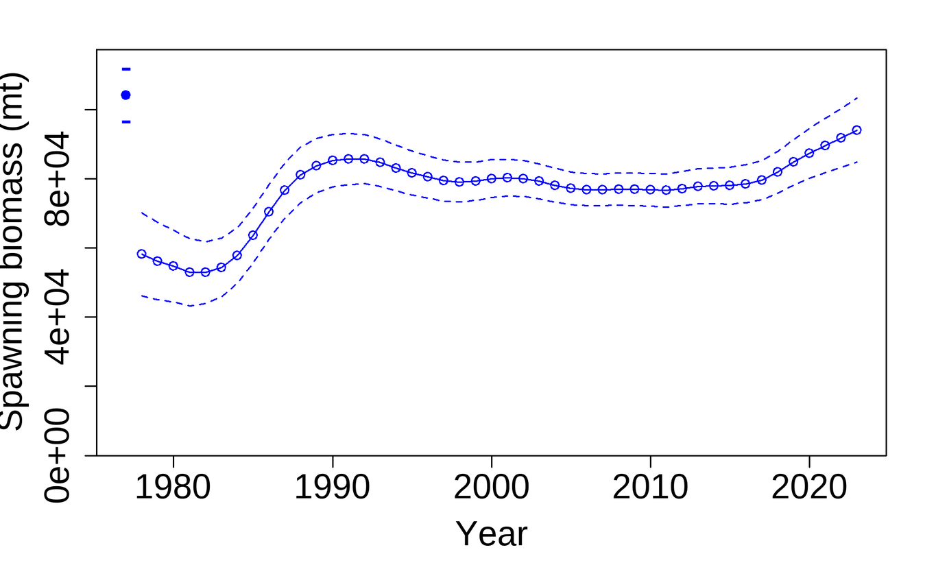
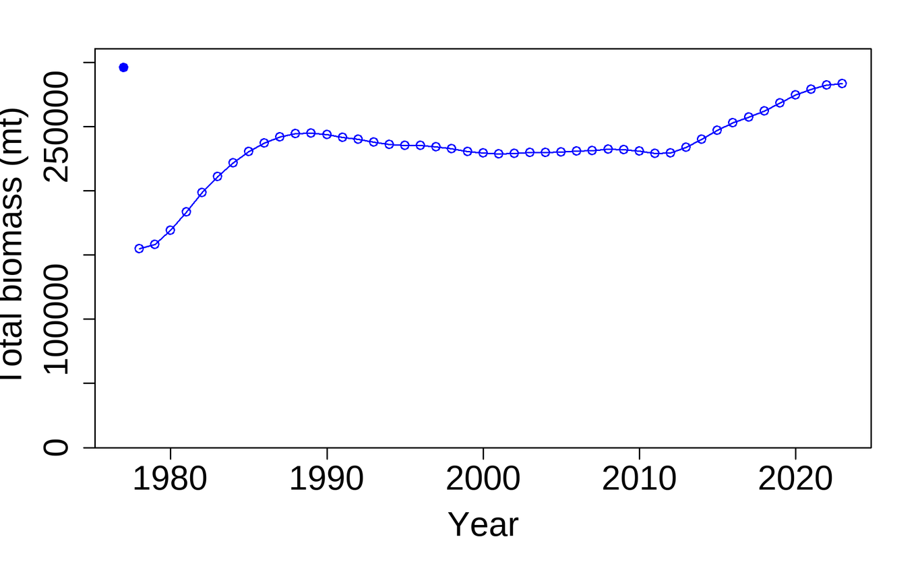
Time Series: SSB & Total Biomass
Notes:
consistent with flat survey and light exploitation, stable, high stock

Slide 20
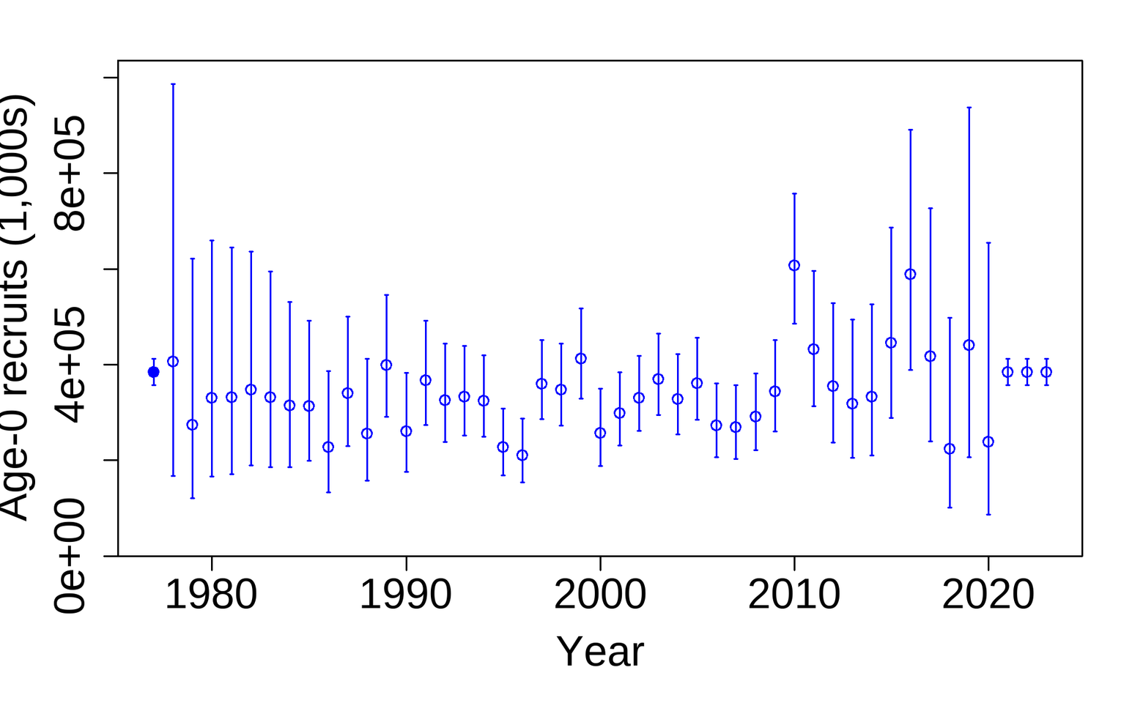
Time Series: Recruitment
Notes:
last 3 years mean recruitment
2 down years all since last assessment, coincident with MHW trickling into prey habitat
I am cautious about treating these as true happenings, but it seems to be consistent with environmental conditions.

Slide 21
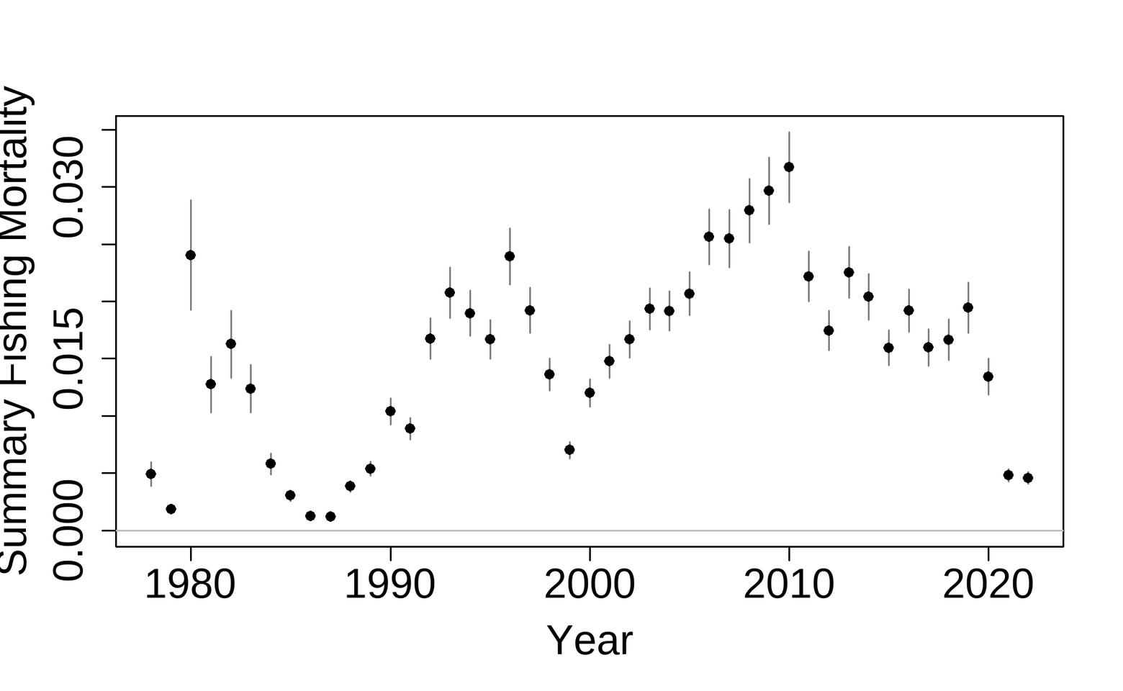
Time Series: Fishing Mortality

Slide 22
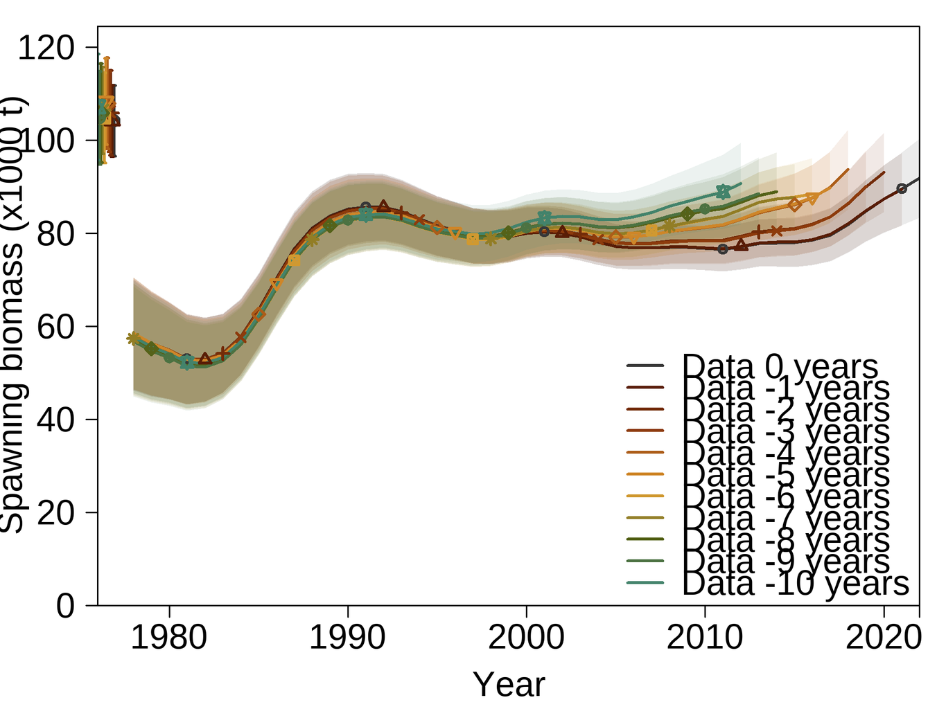

10-year Retrospectives
Quant | Mohn's Rho
SSB | 0.1107
Rec | -0.2704
Bratio | 0.0895
F | -0.0493
Notes:
5 surveys in this period, 3 of them are all higher. Once 2019/2021 dropped fits are great.
Hurtado-Ferro et al Range -0.15 to 0.2
Doesn't really make sense to compare recruitment across these models since it is fixed at the mean for some.

Slide 23
Likelihood Profiles/Sensitivities
Notes:
Multiple profiles including 2d profiles of q, M and r0.
extended range from 2017 assessment.
General curvature is the same; the model found lowest NLL at q around 1.6 and M 0.28 (both sexes). This is consistent with analytical and estimated q explorations.
Look into independent profile of M for both sexes and we see evidence of data conflict; lengths appear to suggest a more productive stock (low M, higher R0) vs the age data, which is suggesting a higher M and otherwise in line with the overall model.
Encouraged to look more closely at data weights.

Slide 24
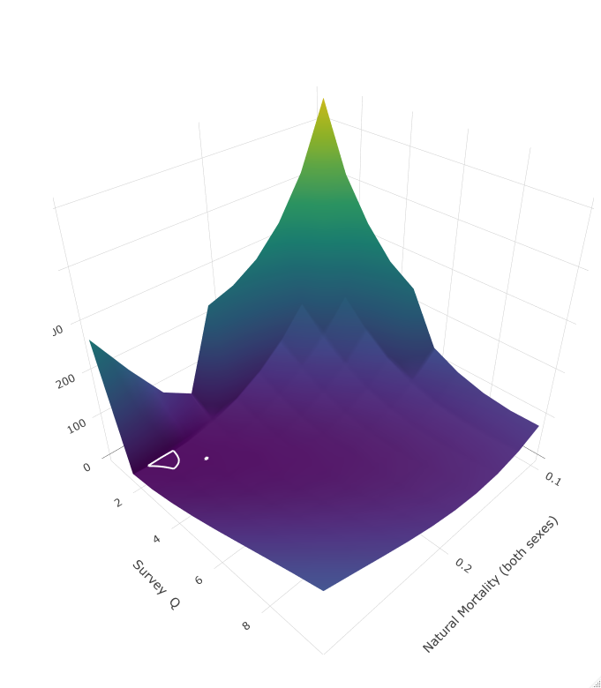
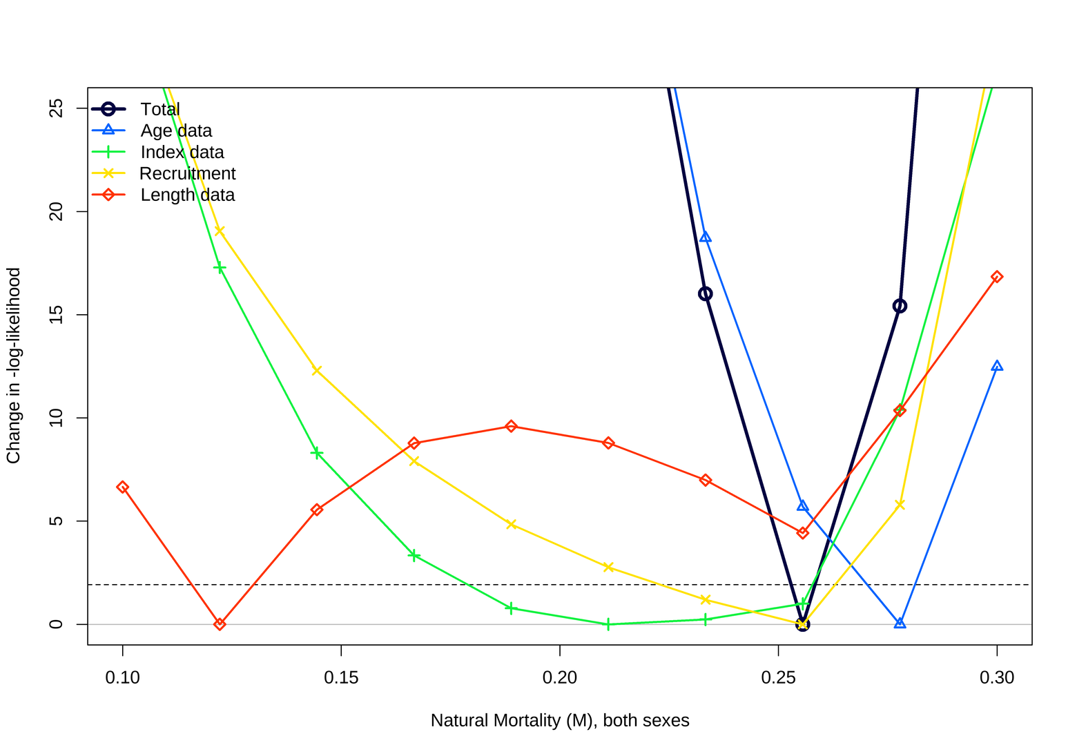
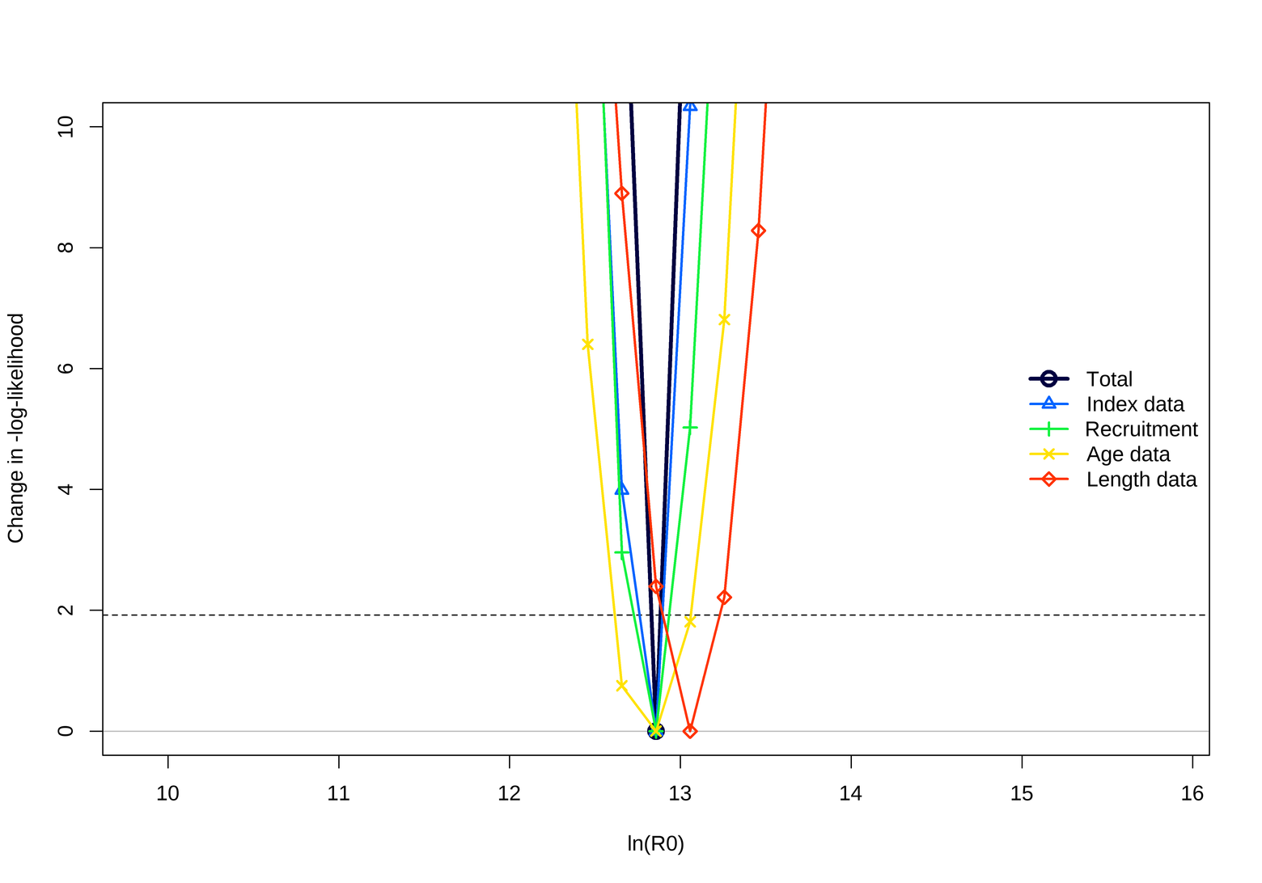
Likelihood Profiles - data conflict!
Notes:
Multiple profiles including 2d profiles of q, M and r0.
extended range from 2017 assessment.
General curvature is the same; the model found lowest NLL at q around 1.6 and M 0.28 (both sexes). This is consistent with analytical and estimated q explorations.
Look into independent profile of M for both sexes and we see evidence of data conflict; lengths appear to suggest a more productive stock (low M, higher R0) vs the age data, which is suggesting a higher M and otherwise in line with the overall model.
Encouraged to look more closely at data weights.

Slide 25
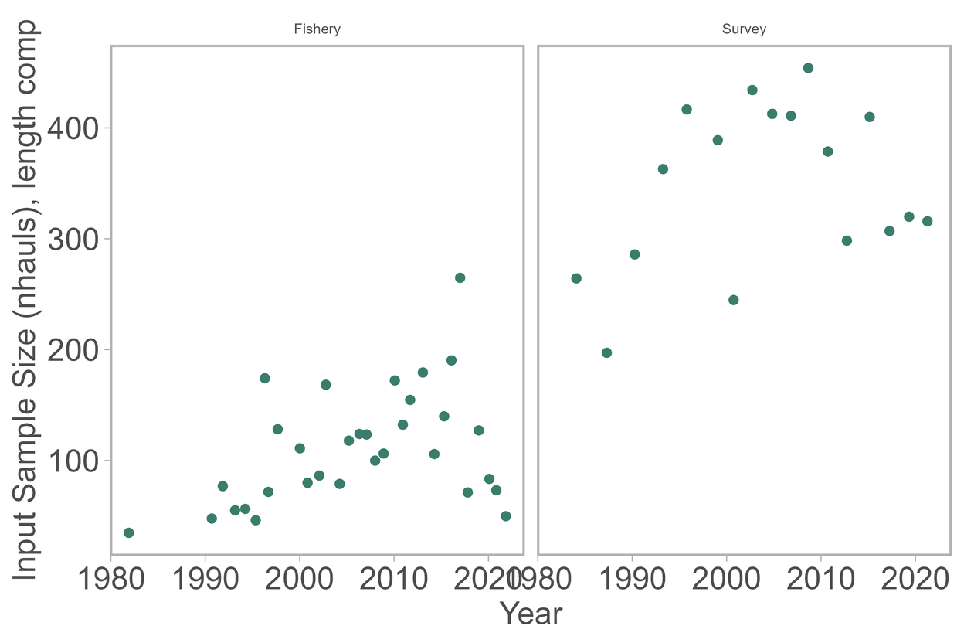
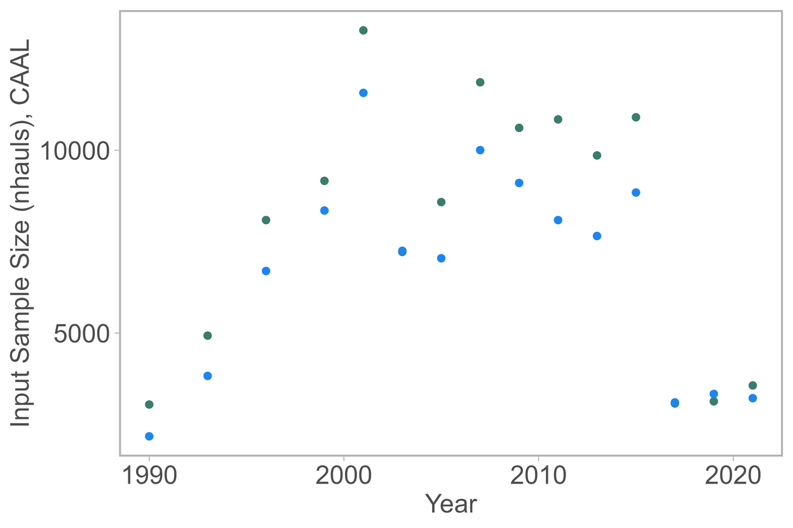
Data Weights i
Notes:
backstory: inputs as nhauls
not based on analysis
hope weights deal with it
in 2017 francis couldn't do caal

Slide 26
Data Weights ii
Data Type | 2017 M-I Weight | 2022 M-I Weight | 2022 Francis weight (not used)
Fishery Length | 1.190 | 1.248 | 0.215
Survey Length | 1.017 | 1.097 | 0.470
Survey CAAL | 0.345 | 0.327 | 0.216
Both methods downweight CAALs
Recall Francis TA1.8 is based on Pearson residuals
No large trajectory differences between methods
Notes:
Faithful to structure, update MI weights in blue. Also examined Francis weights now that method is good.
Main finding is that both methods downweight CAALs, which we might expect given discrepency in inputN.
Interestingly, the Francis weight wanted to downweight everything. Importantly, no real difference in derived quants between methods. Tells me that model is leaning on CAALs, which is consistent with what we saw in the R0 plot.
MI might overweight comp data; Punt observed francis typically leads to downweights for correlated years "runs".

Slide 27
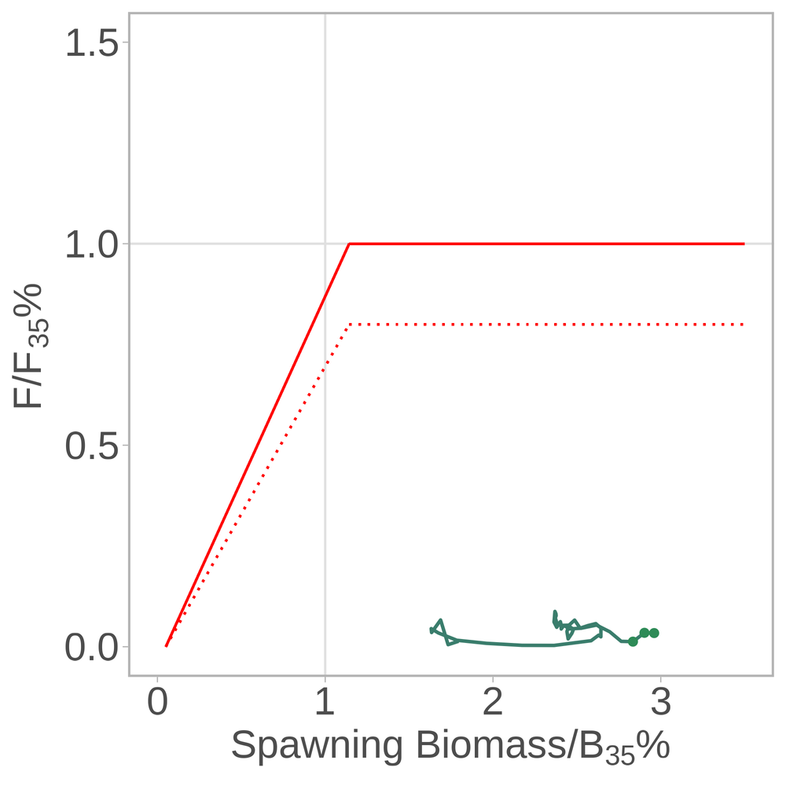
Phase Plane
Notes:
three dots are 2022-2024
no overfished nor ovefishing

Slide 28
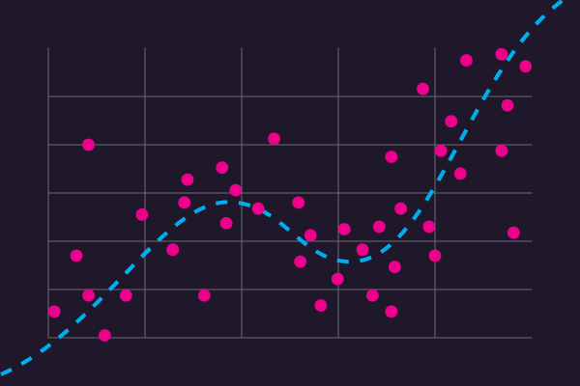
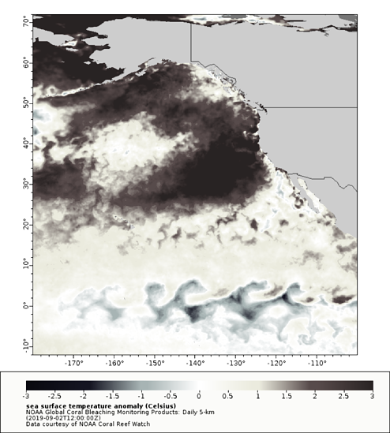

Risk Table (Level 1, all categories)
Assessment
PopDy/Fishery
Environment
Model estimated with convergence.
New data minimally influential
Thermal conditions average to good at present.
Prey dynamics unknown.
Very lightly exploited
MHW likely impacting prey availability and mean length
Notes:
could fishery be moving more shallowly to avoid bycatch? haven't looked at sptl dynamics

Slide 29
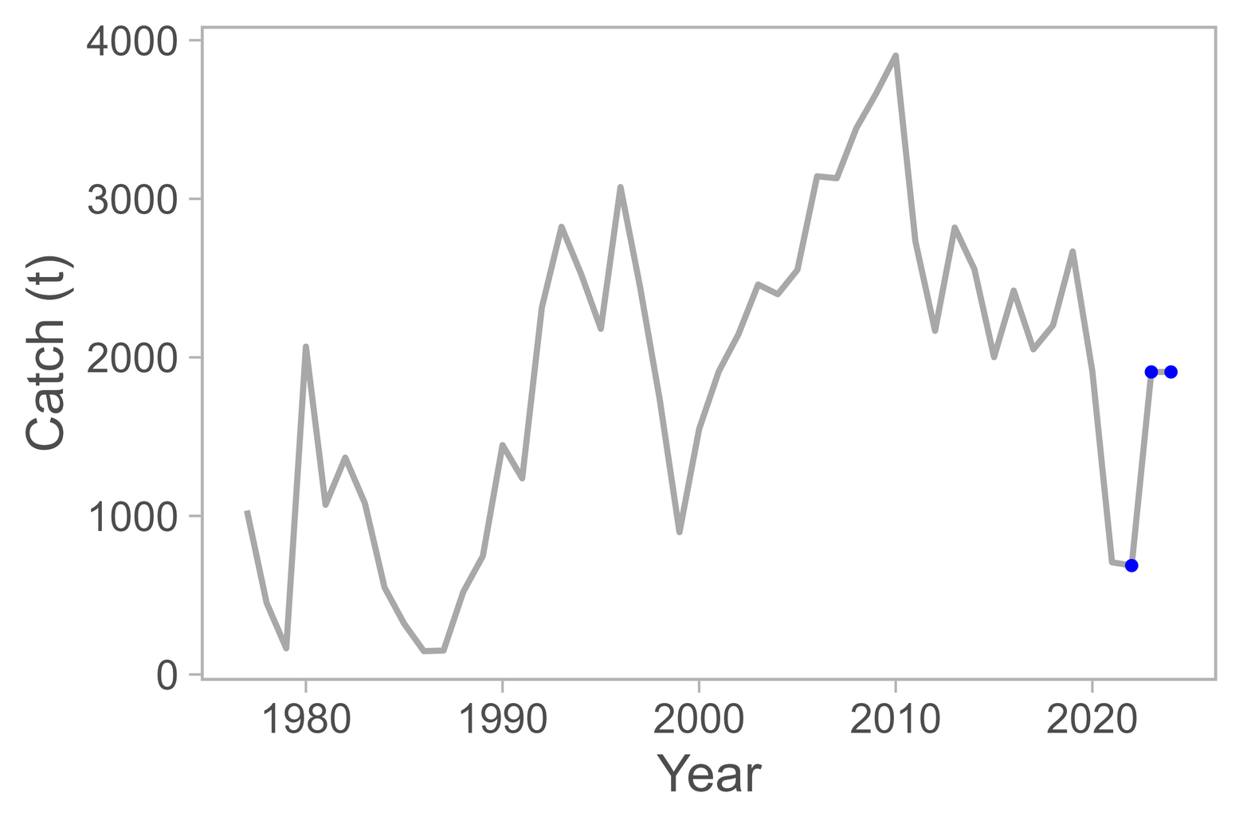
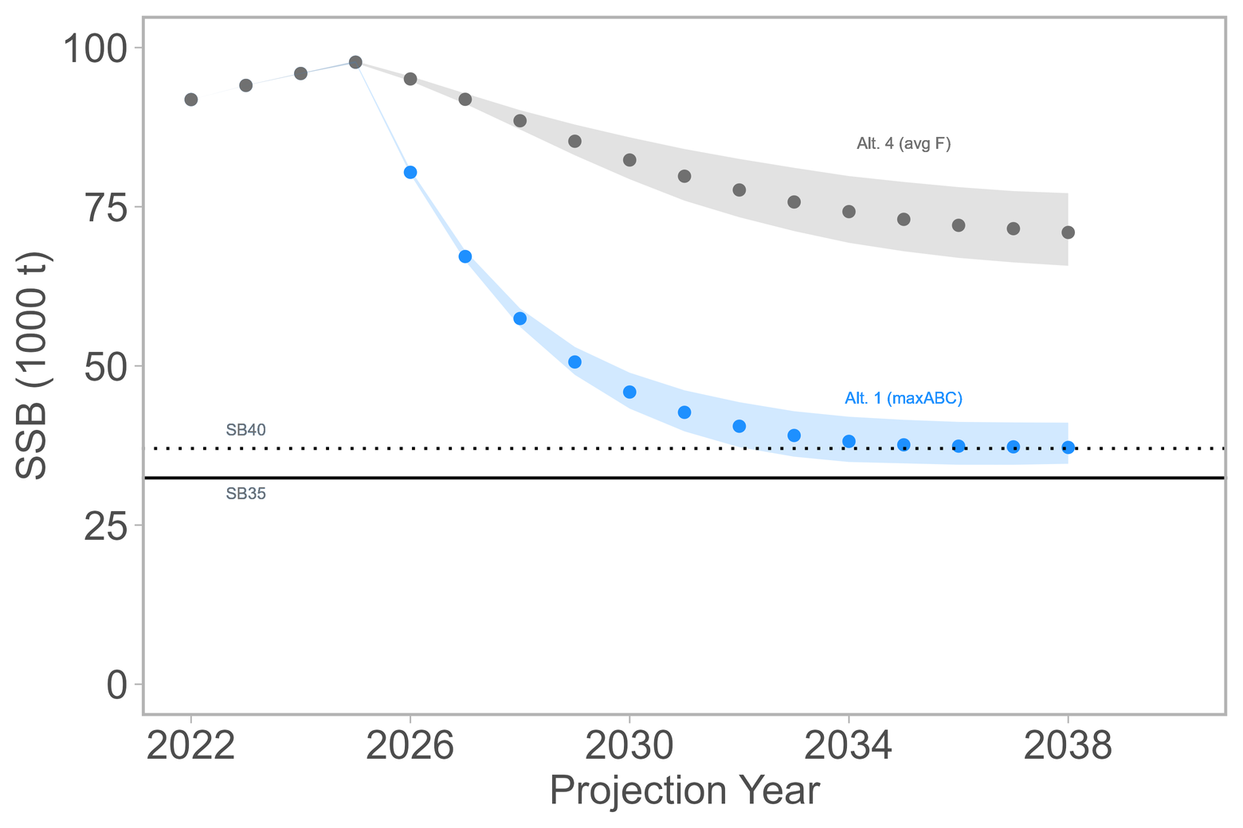
Projection
Notes:
not super realistic to show scenario 1 since we are so much lower than max ABC. scenario 4 is more like it.

Slide 30
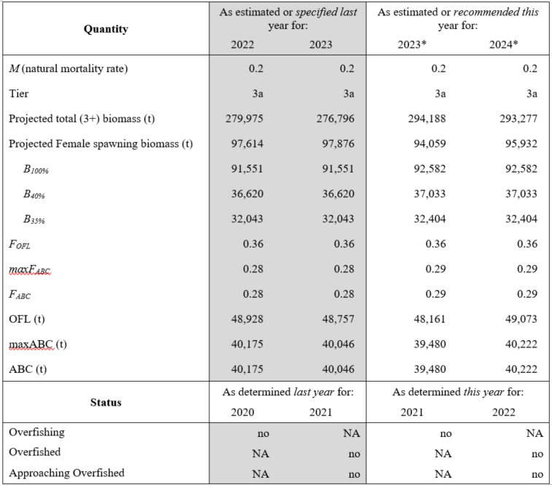
Harvest Recommendation
1% change in ABC from last year
Notes:
22 proj = 687

Slide 31
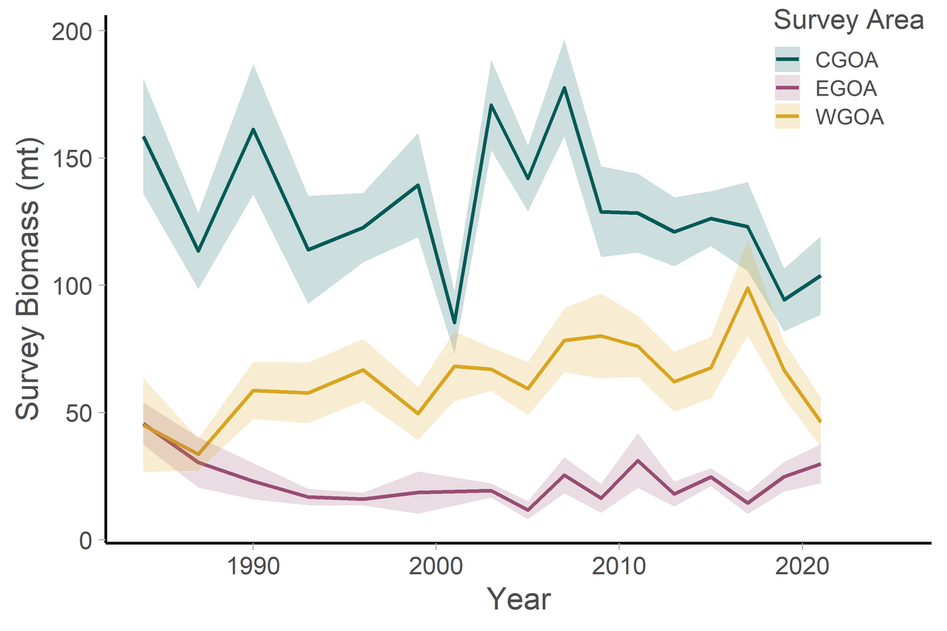
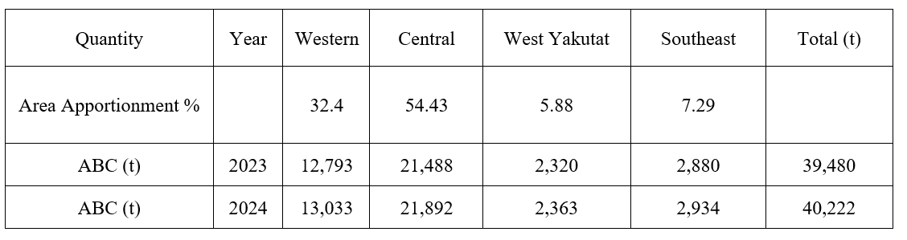
Apportionment
Check out https://github.com/afsc-assessments/rema

Slide 32


Data Gaps & Future Research
Examine interaction between data weights and catchability
Consider priors for M/q
Revisit selex

Slide 33

Thank you!
maia.kapur@noaa.gov

Slide 34
Extra Links (Sensitivity Runs)
https://mkapur-noaa.github.io/goa-fhs-2022/sensitivities_goa_fhs_2022.html
https://mkapur-noaa.github.io/goa-fhs-2022/AgeingError_Writeup_Static.html

Slide 35
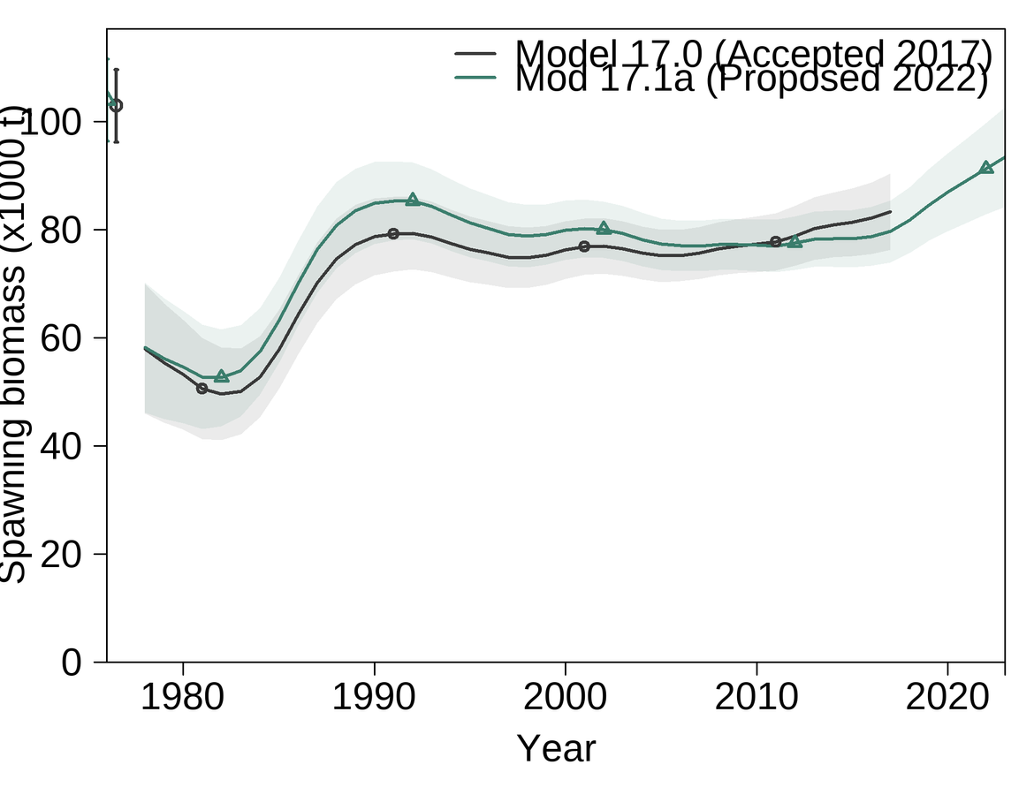
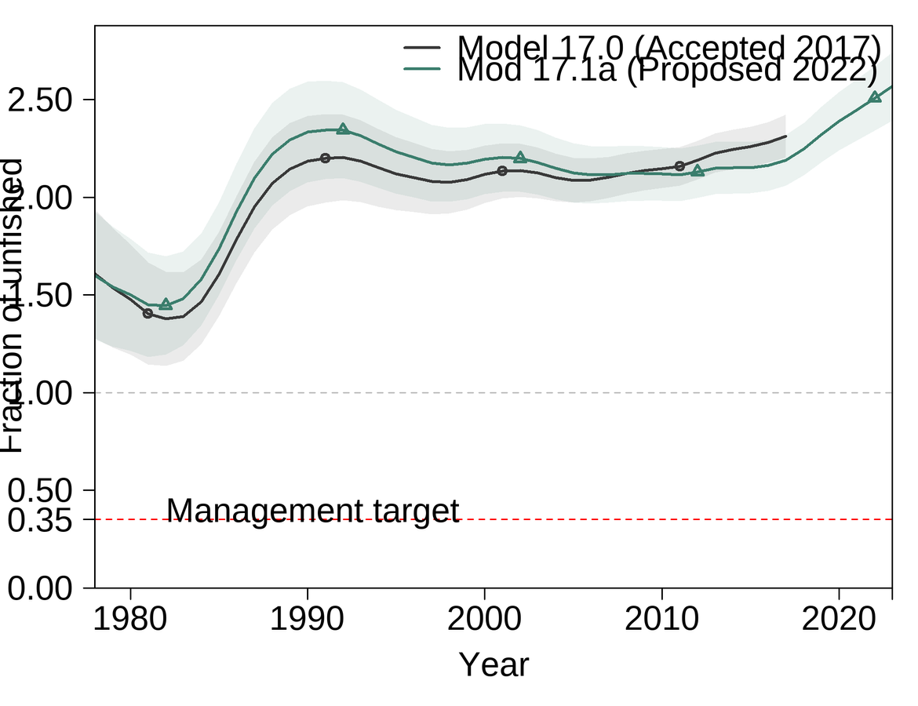
Comparison with 2017 i
Notes:
note that the black lines here are the bridged 2017 models.

Slide 36
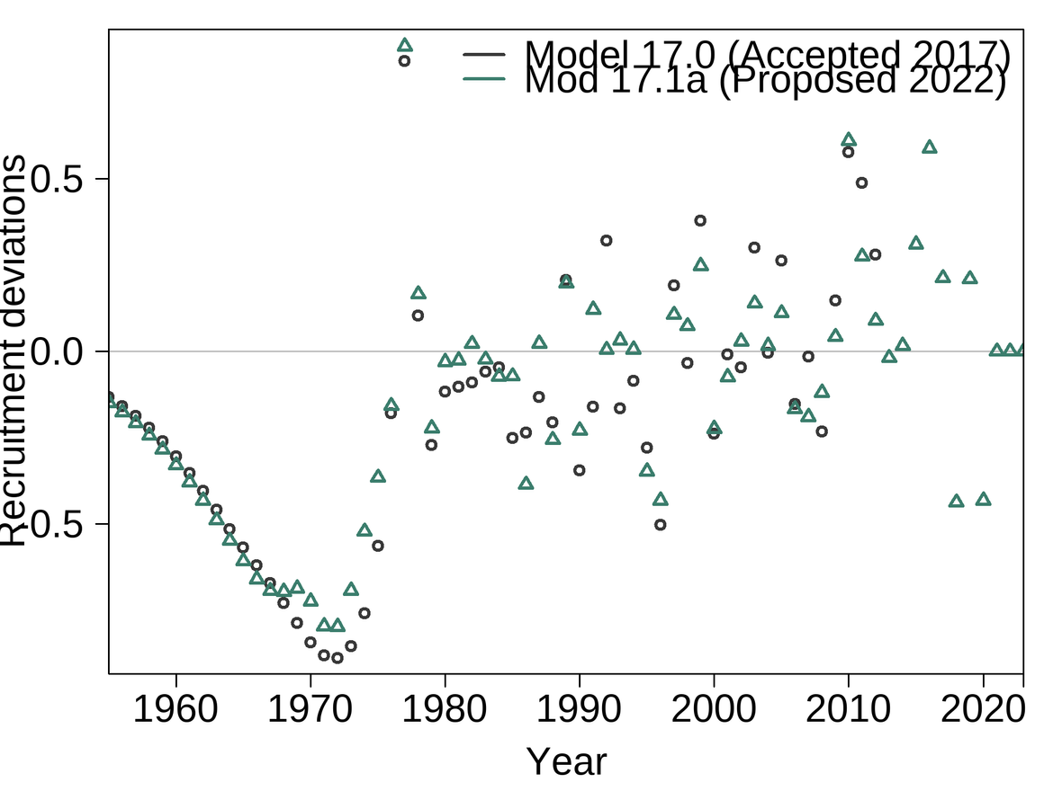
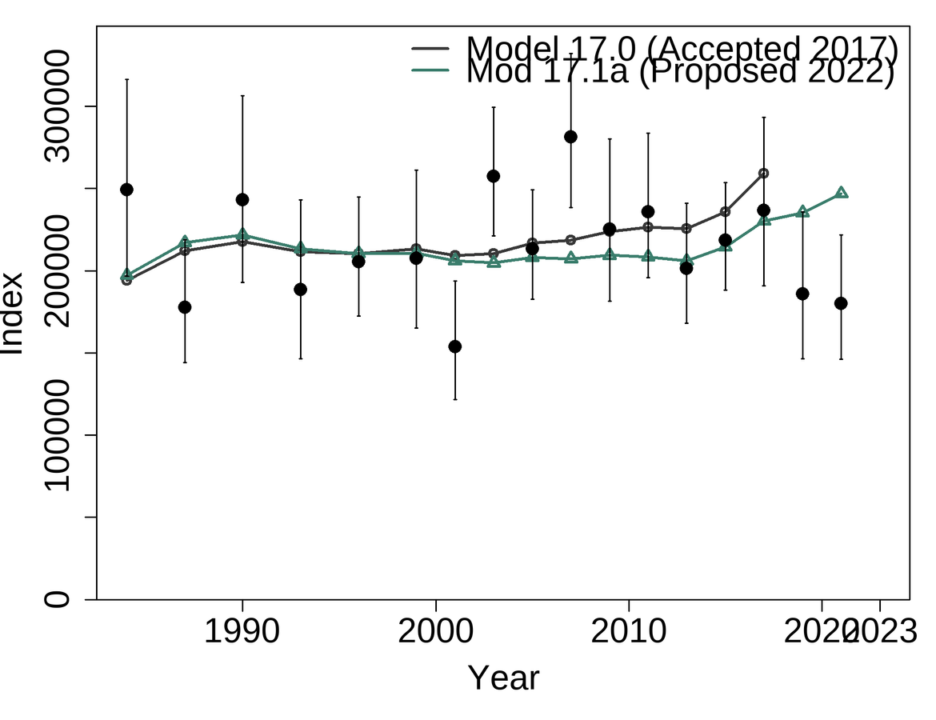
Comparison with 2017 ii

Slide 37
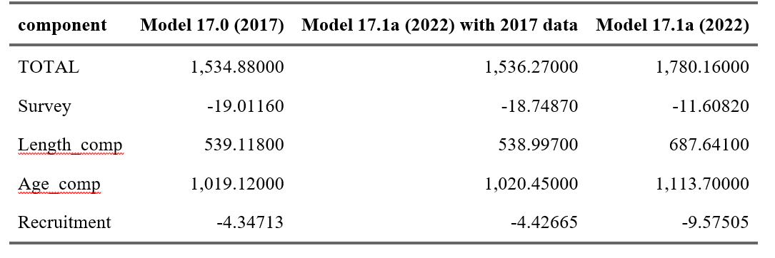
Comparison with 2017 iii
Notes:
these are the actual values from each.

Slide 38
slides for Director's Briefing, 02 Nov 2022

Slide 39
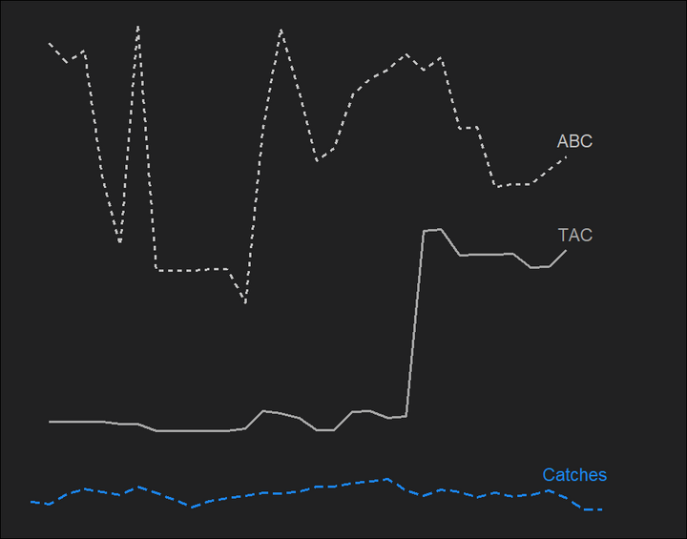
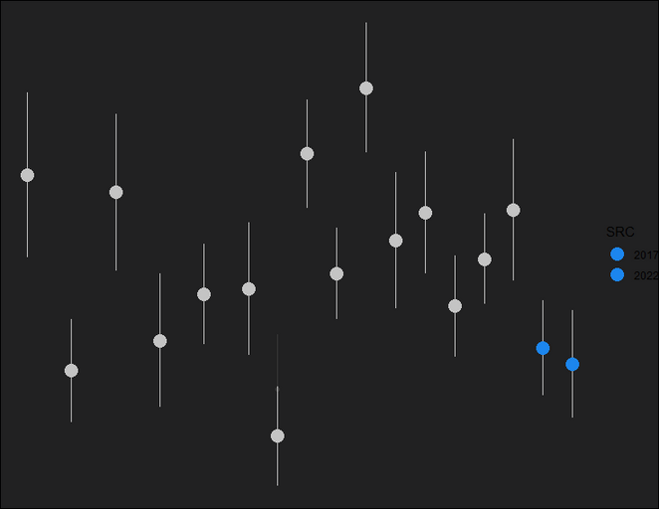
GOA Flathead Sole: Data
Last two years of survey down
2016 MHW likely catching up with data
Catch is <10% ABC
Approaching bycatch status
Still highest in Central GOA
Not out of historical range
Reduced prey availability
Lower recruitment devs and mean lengths

Slide 40
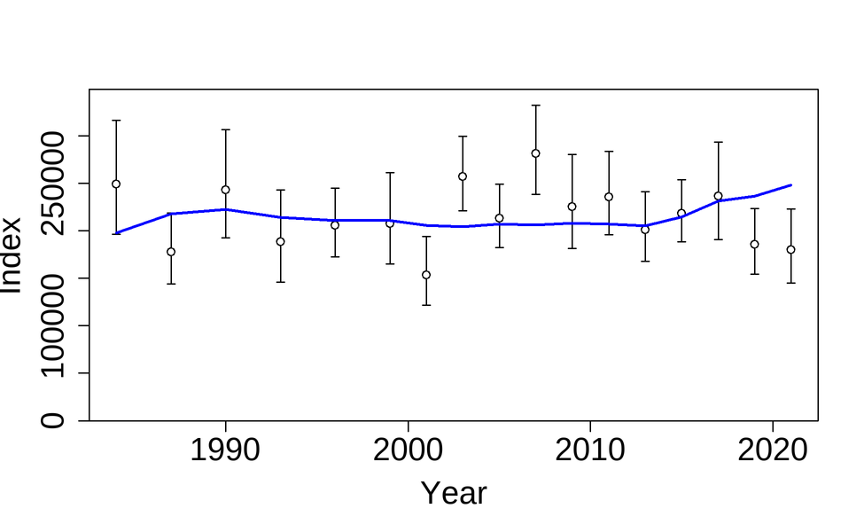
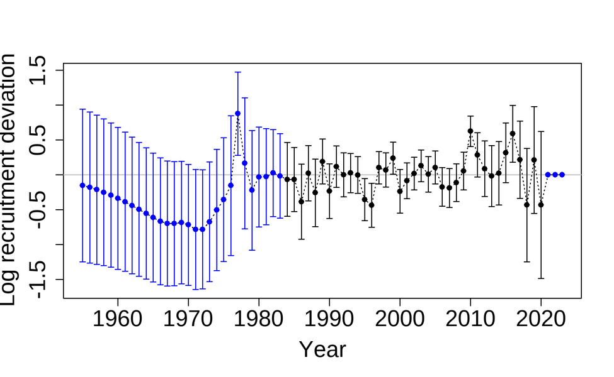

GOA Flathead Sole: Model
No Changes to Model
Recruitment
ABC
Slight overfit last two years of survey data with q, M, weighting constraints
Keep an eye on response to climactic conditions
in 2023 is 48,161 t, ~1% difference from last year
Model is structurally stable and robust to new data

